Slide 1
Analysis of Common Trend Strategies Using ML
Christian Ruiz, COMP 642-901

Slide 2
- Trend Strategy - Objective - Data Requirements - Model Analysis - Model Optimization - Conclusions

Slide 3
- Trend Strategy - Objective - Data Requirements - Model Analysis - Model Optimization - Conclusions

Slide 4
Elements of our Trend Strategy
Capture gains through momentum
Momentum
Technical Analysis vs Fundamental
Moving Averages

Slide 5
- Trend Strategy - Objective - Data Requirements - Model Analysis - Model Optimization - Conclusions

Slide 6
Objective
Based on daily market close prices of TQQQ, determine if the following 1, 3, 5, 10, or 20-day close price will yield a gain, or a loss compared to the security price at at time 0.

Slide 7
- Trend Strategy - Objective - Data Requirements - Model Analysis - Model Optimization - Conclusions

Slide 8
Data Requirements
Macro Market Data
Technical / Trend Feature Engineering
Investment Simulation
Notes:
Macro Market Data
Interest Rates: TBF 20 year treasury
Inflation: TIP Bonds
Currency: UUP US Dollar
Fear: VIXY Short Term Futures
Commodities: USO & GLD: Oil and Gold
Technical / Trend Data
35-day EMA
200-day SMA
Moving Average Convergence Divergence (MACD)
Technical indicator to help investors identify market entry points for buying or selling.
MACD Line = 12-Period EMA − 26-Period EMA
Signal Line = 9-Period EMA of MACD line
Relative Strength Index (RSI)
Measures speed and magnitude of a securities recent price change
Investment Simulation
Create 1, 3, 5, 10, 20 day future prices
Simulate a Long, Short, Hold based on these future prices

Slide 9
- Trend Strategy - Objective - Data Requirements - Model Analysis - Model Optimization - Conclusions

Slide 10
Data Pre-Processing
20, 60, 120 Rolling Window Period Normalization
Min-Max Scaling
Reshaping Data For RNN
20, 60, 120 period sequence length
26 independent variables
5 dependent variables
Label Encoding
Long, Short, Hold
Principle Component Analysis

Slide 11
Model Analysis
LSTM
XGBClassifier
KMeans

Slide 12
LSTM
Time Series
Multi-Output Regressor
Available Parameter Optimization Techniques

Slide 13
XGBRegressor
Tree Based Model
Robustness to Outliers
Model Interactions Between Features
Does not account for Time Series Nature of Data

Slide 14
KMeans
Not a Means of Predicting Price
Clusters For Seasonality or Momentum
Added Feature for Another Model

Slide 15
- Trend Strategy - Objective - Data Requirements - Model Analysis - Model Optimization - Conclusions

Slide 16
Model Optimization
Kmeans
optuna module
n_clusters, init, n_init
Silhouette = 0.45
LSTM
keras_tuner module
units, dropout, optimizer
MSE = 0.12
Notes:
n_clusters – number of centroid clusters
init – initialization impacts the speed of convergence and likelihood of discovering the global optimum
n_init – number of times the algorithm will be run with different seeds
units – number of layers in the LSTM network
dropout – randomly sets % of input units to 0 at each step, prevents overfitting
optimizer – affects the rate of convergence, significantly impacts efficiency and training.

Slide 17
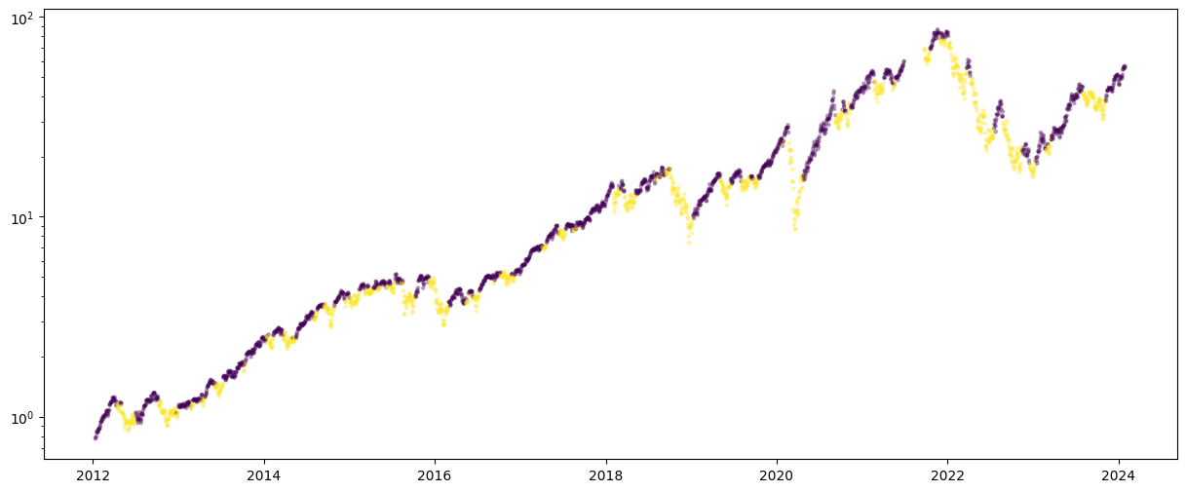

Results - KMeans

Slide 18
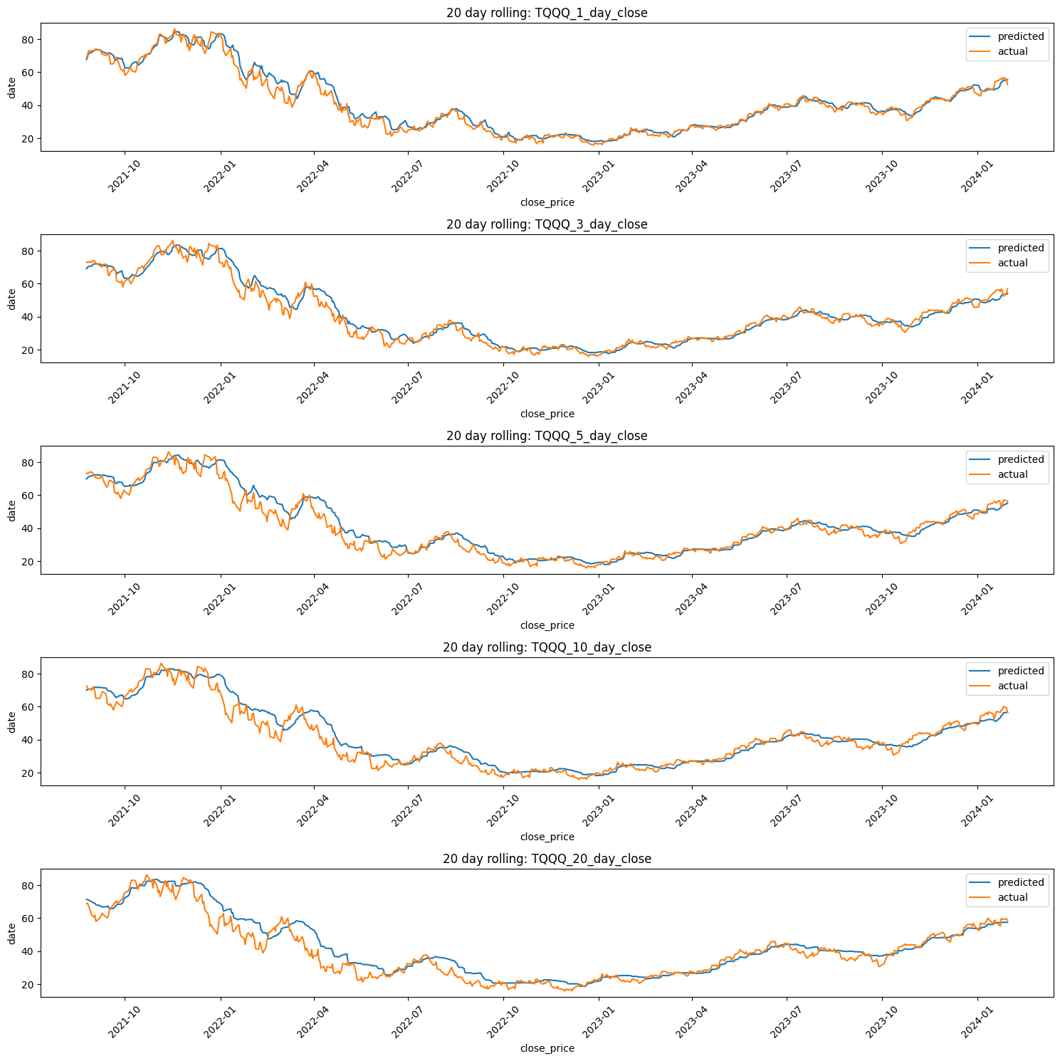
Results - LSTM

Slide 20
Conclusions
Kmeans Does Not Improve LSTM
Model Momentum Classification
Back Testing

Slide 21
Questions?
- Trend Strategy - Objective - Data Requirements - Model Analysis - Model Optimization - Conclusions

